Slide 1
Entity Relationship Data Model

Slide 2
Entity-Relationship Data Model
The Entity-Relationship (ER) Data Model is a conceptual data model used to describe the data that an organization needs to store and the relationships among that data. It is commonly used during the database design process, before the data is converted into relational tables.
An Entity-Relationship Diagram (ERD) is the graphical representation of an Entity-Relationship Data Model.

Slide 3
The five main components of an ERD:
Component | Purpose | Chen notation
Entity | A person, place, object, event, or concept about which data is stored | Rectangle
Attribute | A property or characteristic of an entity | Oval
Relationship | Describes how entities are associated | Diamond
Cardinality | Specifies the maximum number of entity instances that can participate in a relationship | 1:1, 1:N, M:N
Participation | Specifies whether an entity's participation in a relationship is optional or mandatory | Single line = partial; double line = total

Slide 4
There are also variations within these components
For entities, you can have:
Strong entity
Weak entity
For attributes, you can have:
Simple attribute
Composite attribute
Key attribute
Multivalued attribute
Derived attribute
Partial key (for weak entities)
For relationships, you can have:
Unary (recursive)
Binary
Ternary
Identifying relationship (for weak entities)

Slide 5
Different notations/styles used to draw Entity-Relationship Diagrams, the most common are:
ERD Notation | Main Characteristics | Common Use
Chen Notation | Rectangles for entities, ovals for attributes, diamonds for relationships | Teaching and conceptual database design
Crow's Foot Notation | Entities shown as table-like boxes; relationship lines use "crow's feet" to indicate many | Very common in practical database design
UML Class Diagram | Classes/entities shown as boxes with attributes; multiplicities such as 1, 0..* | Software engineering and object-oriented design
IDEF1X | Detailed notation emphasizing primary keys, foreign keys, and identifying relationships | Enterprise and technical database modeling
Barker Notation | Similar to Crow's Foot; uses lines and symbols for optionality and cardinality | Historically associated with Oracle modeling

Slide 6
Chen and Crow's Foot notation can both represent the fundamental structure of an ER model, but they emphasize different aspects of database design.
Chen notation is particularly suited to conceptual modeling, while Crow's Foot notation is commonly used for logical database modeling and shows cardinality and optionality very clearly.

Slide 7

Chen Notation ERD (Entity-Relationship Diagram) is a graphical method used to design and represent the structure of a database.
It was introduced by computer scientist Peter Chen in 1976. Chen notation shows the entities in a database, their attributes, and the relationships between those entities.

Slide 8

Entities
An entity represents a person, place, object, event, or concept about which the database needs to store information.
Examples include:
Employee
Department
Student
Course
Customer
Product
In Chen notation, an entity is represented by a rectangle.

Slide 9
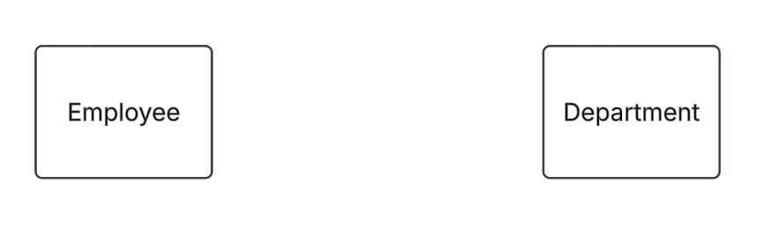
Lucidchart (https://lucid.co/lucidchart, lucid.app)
Use UML Entity Relations Diagram Template
Activity:Draw the two entites Employee and Department

Slide 10
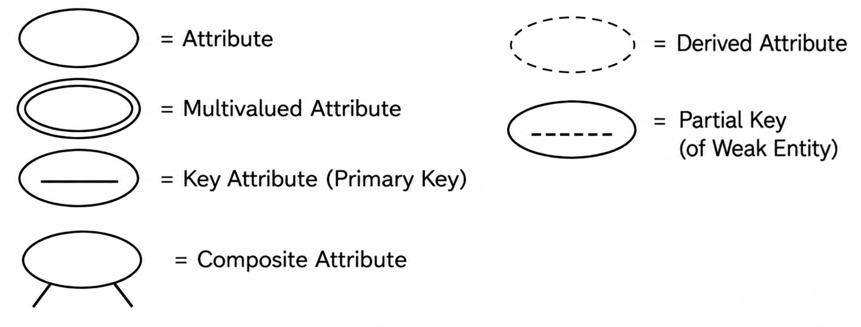
Attributes
An attribute describes a characteristic of an entity or a property of a relationship.
For example, the EMPLOYEE entity might have:
EmployeeID
Name
Phone
Address
In Chen notation, attributes are represented by ovals connected to their entity.
Different types of attributes can also be represented, such as key attributes, composite attributes, multivalued attributes, and derived attributes.

Slide 11
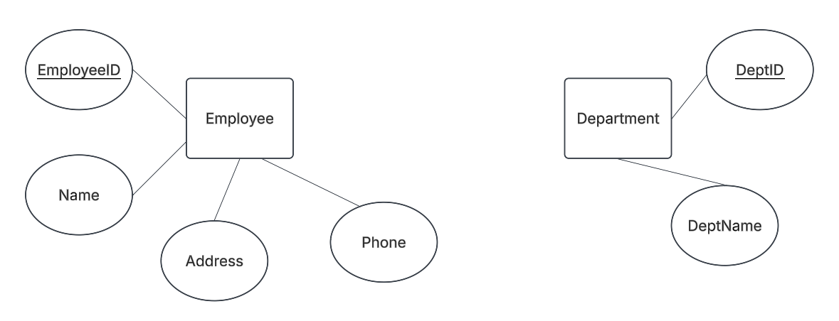
Activity: Draw the Appropriate Attributes for Employee and Department Entites

Slide 12
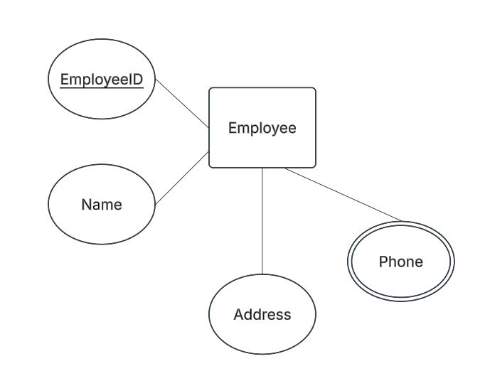
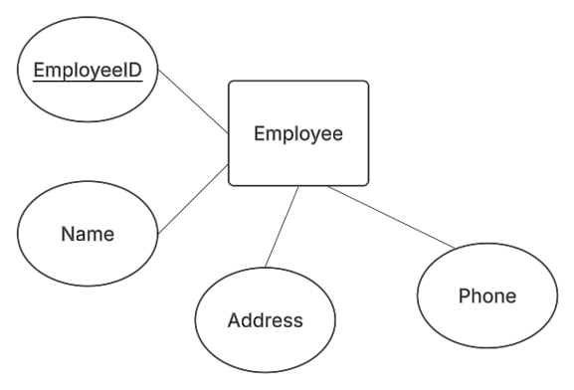
Activity: Draw the correct attribute symbol. The employee can have more than one phone record in the company

Slide 13
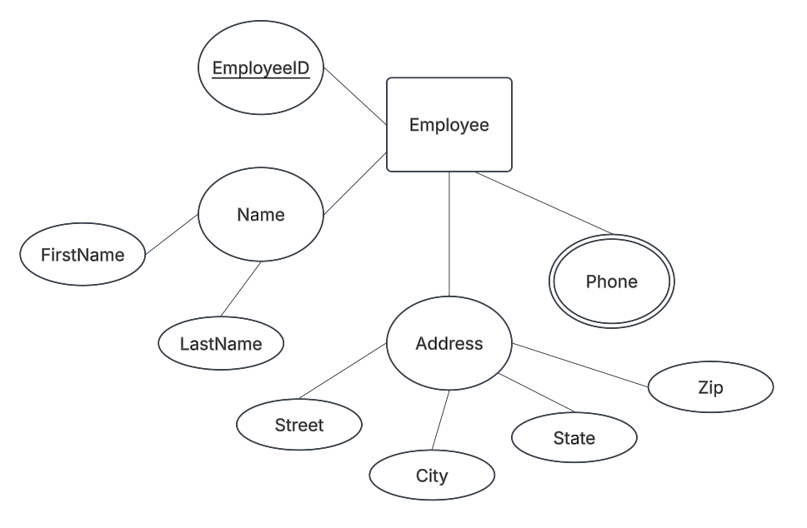
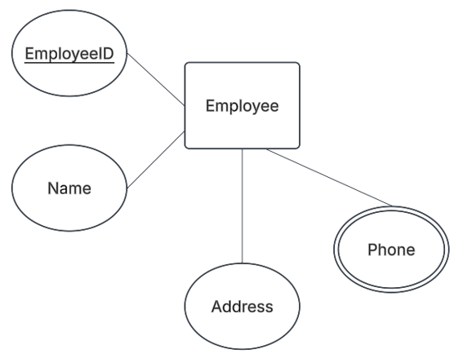
Activity: 1. The company wants the ability to sort the employees based on their last names and first names.
2. The company wants to be able to determine which city each employee resides.

Slide 14
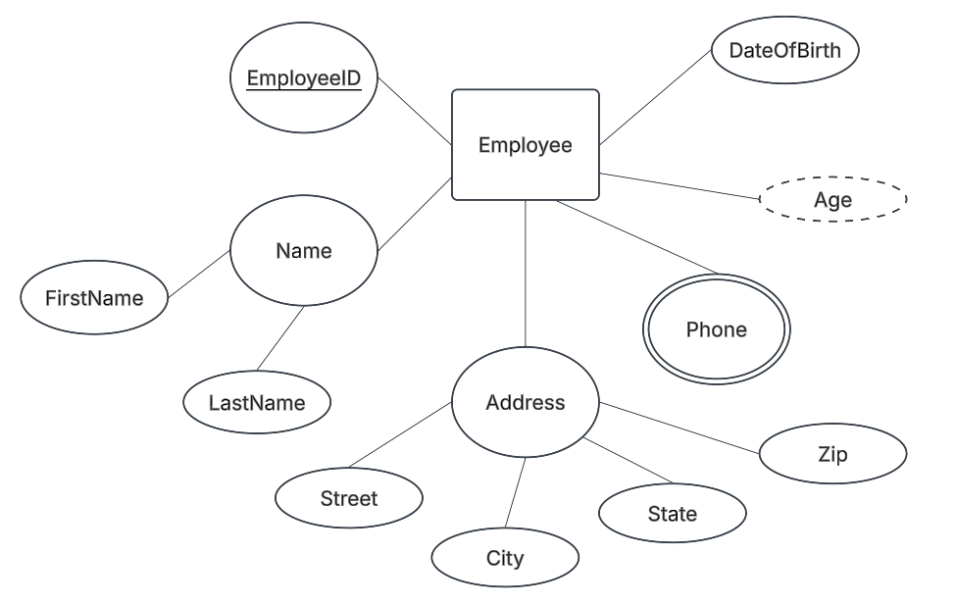
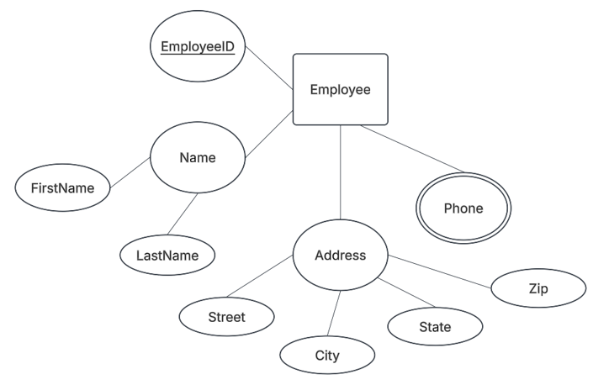
Activity: Now, what if the company needs to know the age of each employee?

Slide 15
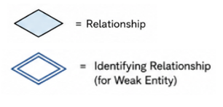
Relationships
A relationship describes an association between entities.
For example:
An EMPLOYEE WORKS_FOR a DEPARTMENT.
In Chen notation, the relationship is represented by a diamond:

Slide 16
For relationships, you can have:
Unary (recursive)
Binary
Ternary
Identifying relationship (for weak entities)
Types of Relationships:
Unary (recursive) — involves one entity type. Example: EMPLOYEE — Supervises — EMPLOYEE
Binary — involves two entity types. Example: EMPLOYEE — WorksFor — DEPARTMENT
Ternary — involves three entity types simultaneously. Example: SUPPLIER — Supplies — PART — PROJECT
N-ary – involves more than three entity types simultaneously.
In terms of relationship degree, the binary relationship is by far the most common in ERDs.

Slide 17
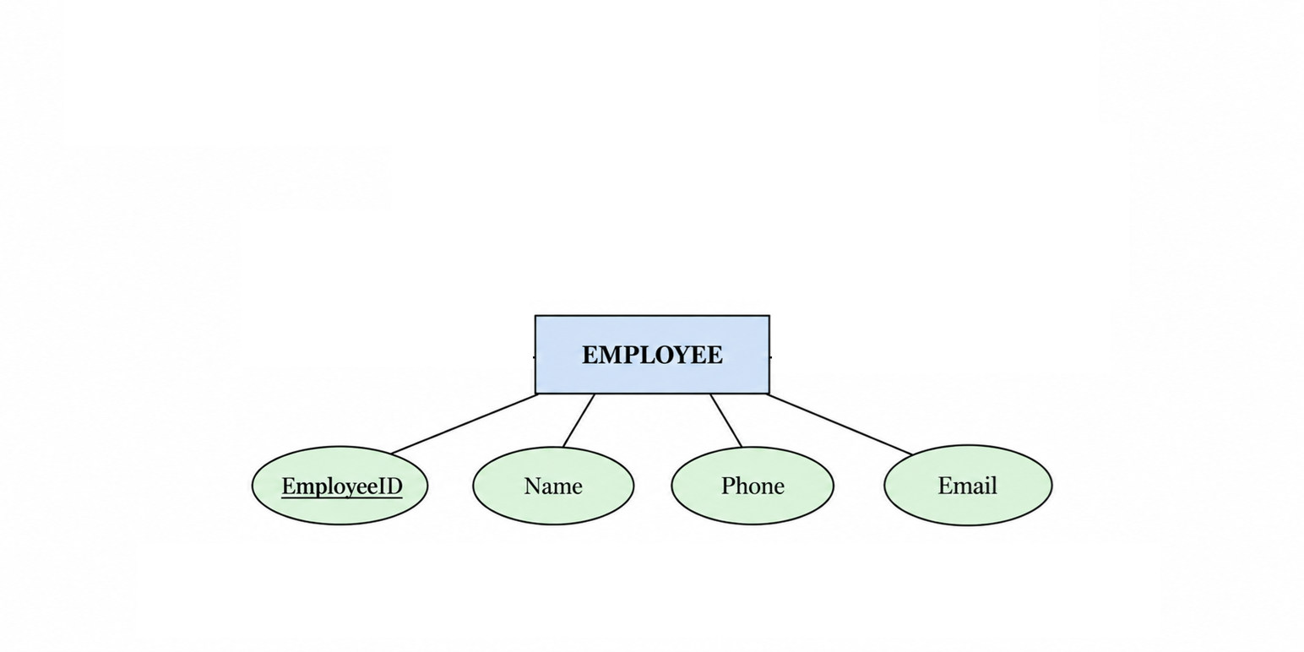
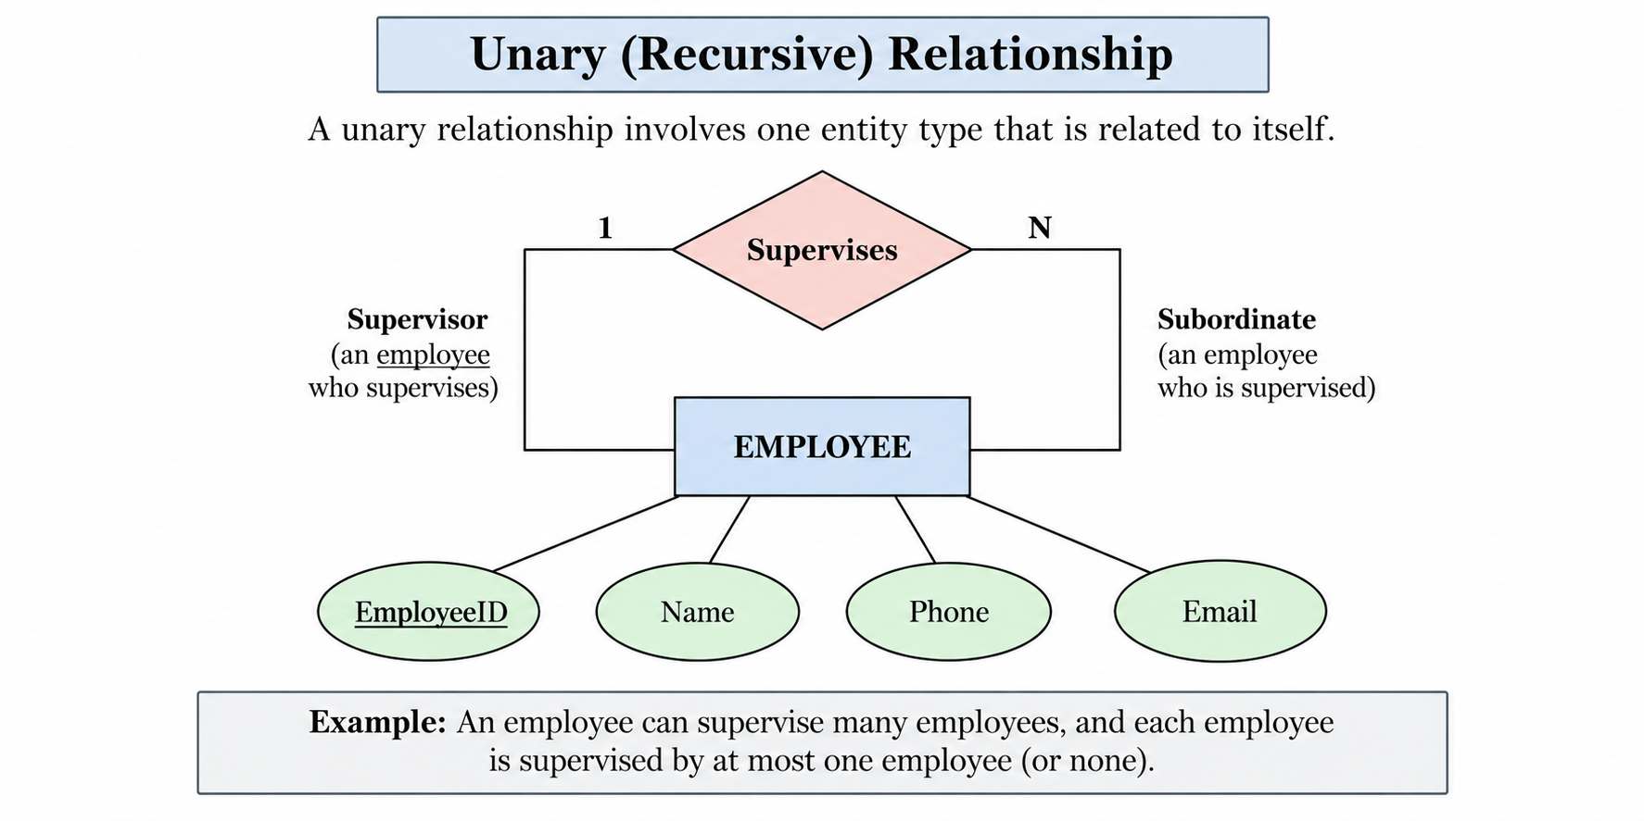
Activity: An employee can supervise many employees, and each employee is supervised by at most one employee.

Slide 18
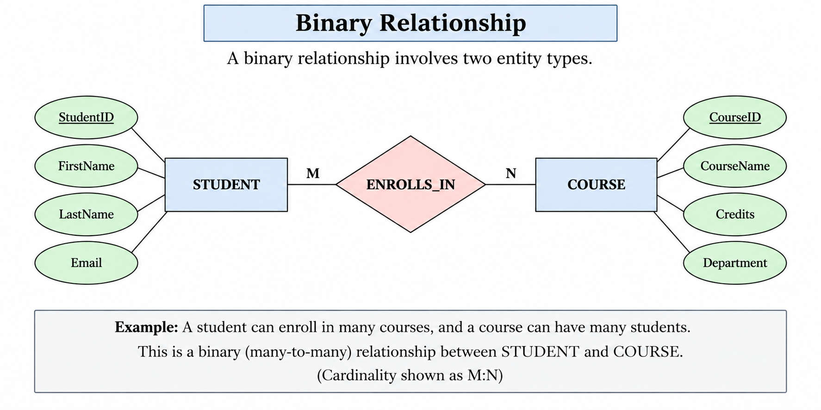
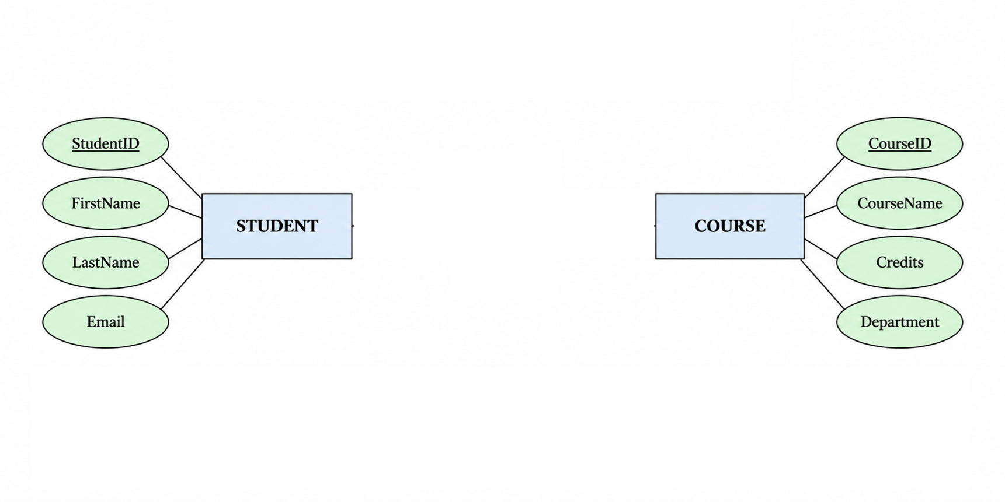

Slide 19
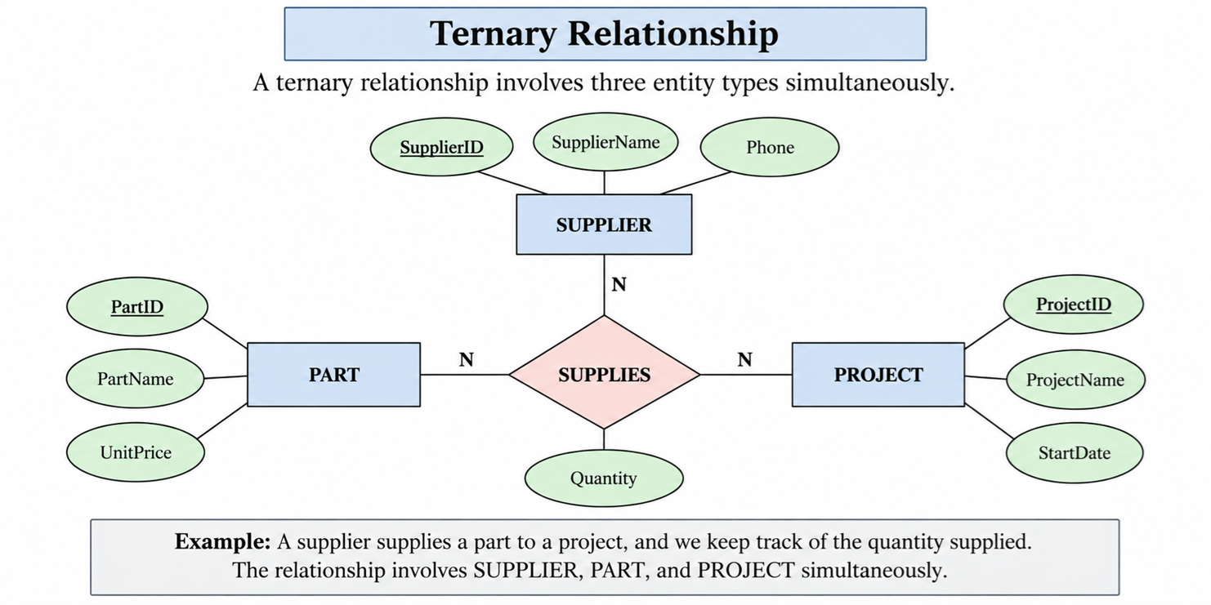
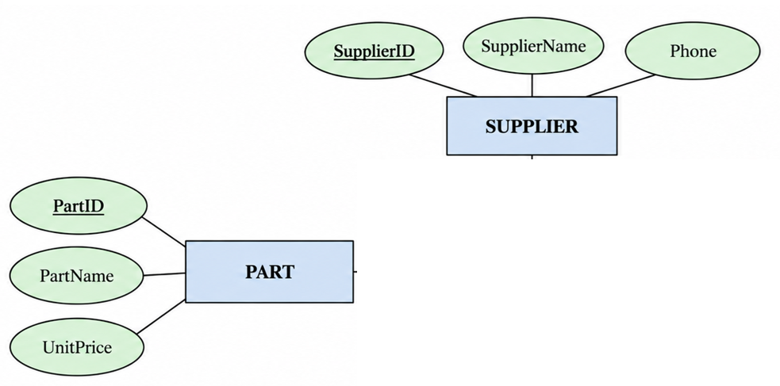
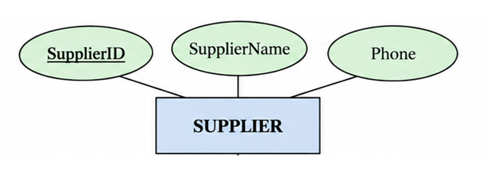
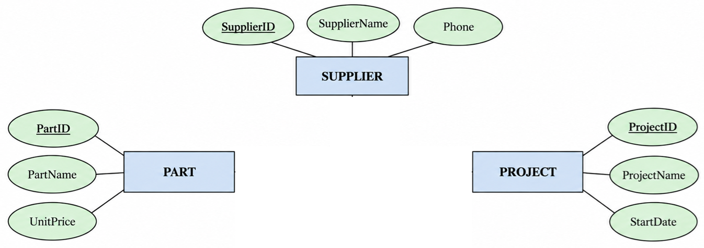
Activity: A supplier supplies a part to a project, and we keep track of the quantity supplied per project

Slide 20
Why Use a Ternary Relationship?
A ternary relationship involves three entity types that must be considered together to represent a complete fact.
Why not use separate binary relationships?
Supplier — Part tells us what the supplier supplies.
Supplier — Project tells us which projects the supplier serves.
Part — Project tells us which parts a project uses.
But these separate relationships do not tell us which supplier supplies which specific part to which specific project.
Use a ternary relationship when breaking it into binary relationships would lose the meaning of the three-way association.
A very useful test is:
If I break this into binary relationships, can I still determine exactly which A is associated with which B and which C?

Slide 21
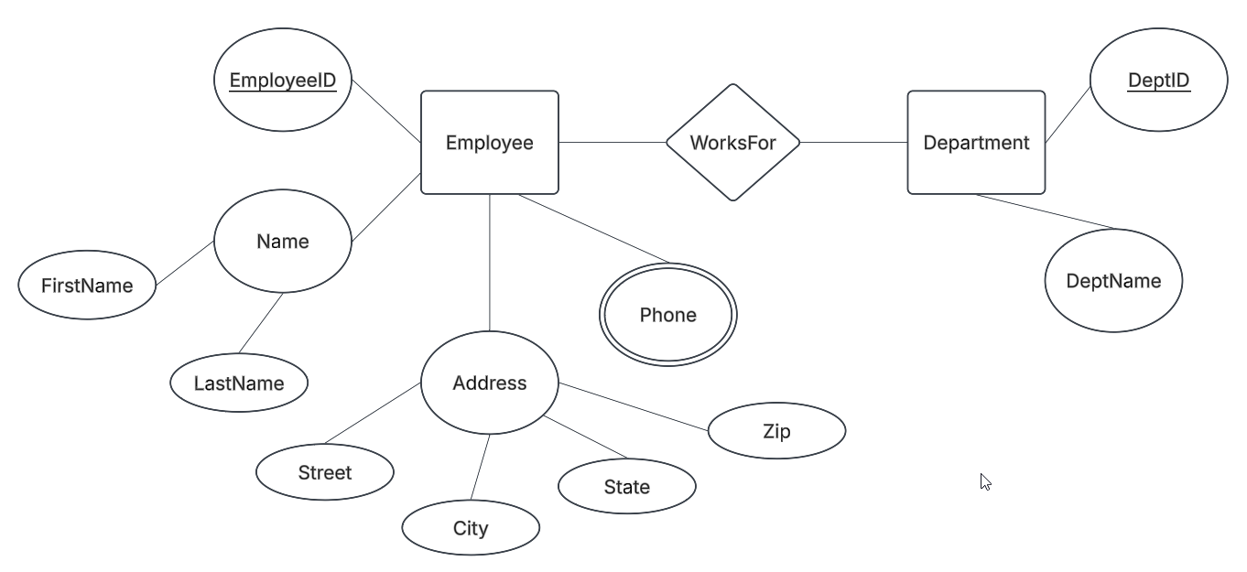
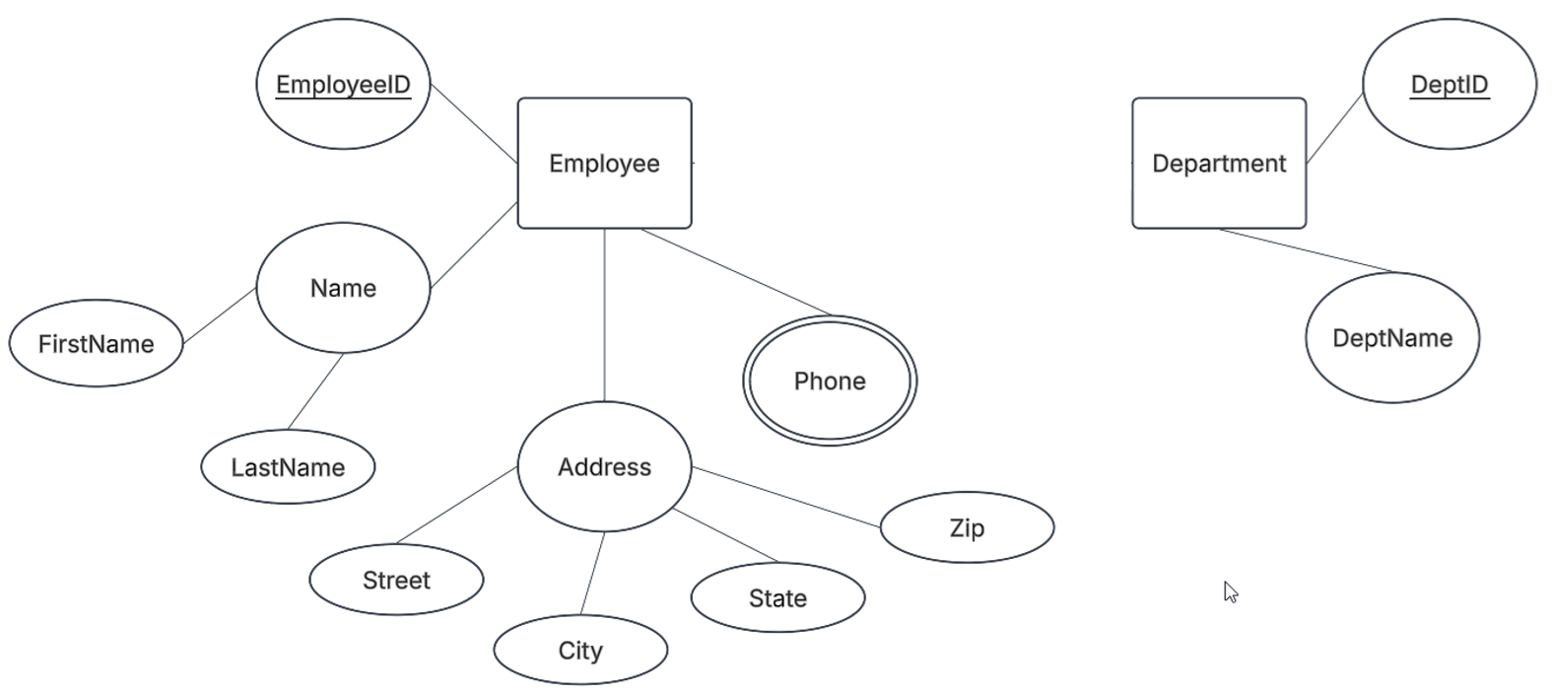
Activity: Draw the relations between Employee and Department using a WorksFor relationship

Slide 22
Cardinality
An ERD can also specify cardinality, which describes how many instances of one entity can be associated with instances of another entity.
For example:
EMPLOYEE ── N ── ◇ WORKS_FOR ◇ ── 1 ── DEPARTMENT
This represents a many-to-one relationship:
Many employees can work for one department.
Common cardinalities include:
1:1 — One-to-One
1:N — One-to-Many
M:N — Many-to-Many

Slide 23
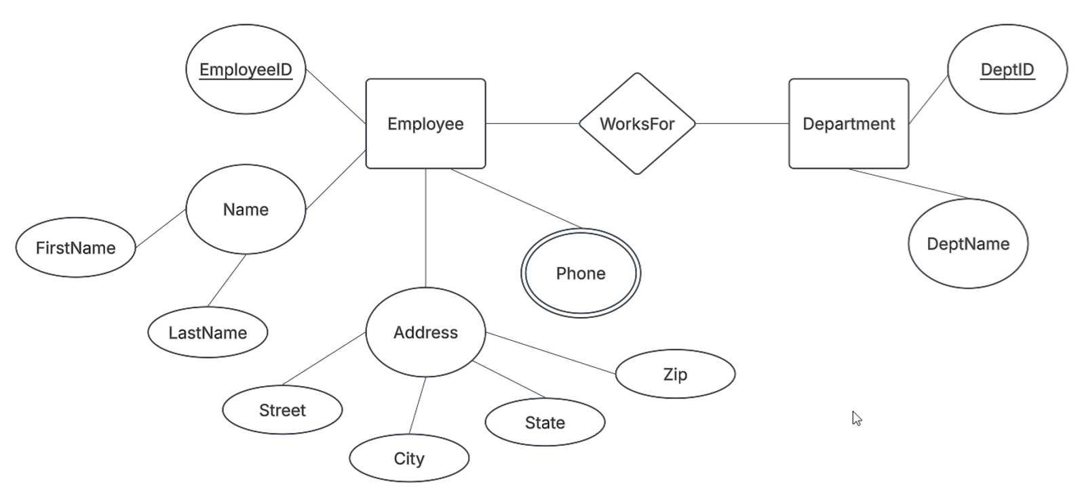
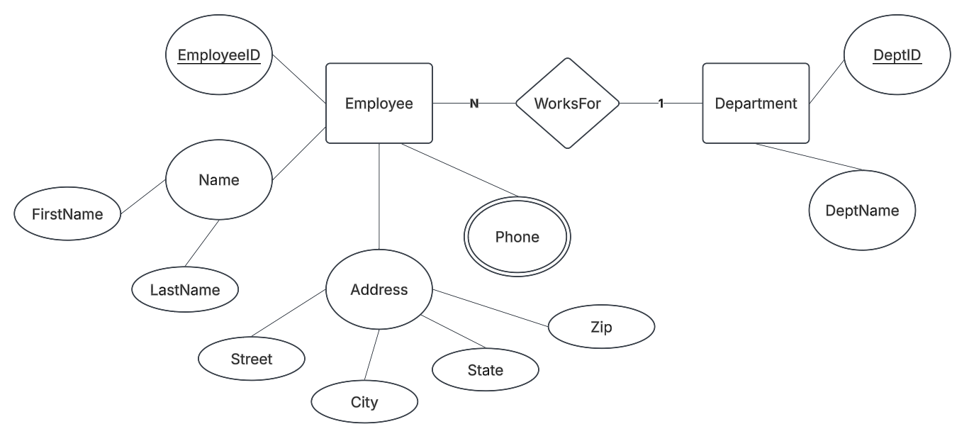
Activity: Add the cardinality. An employee can work for at most one department

Slide 24

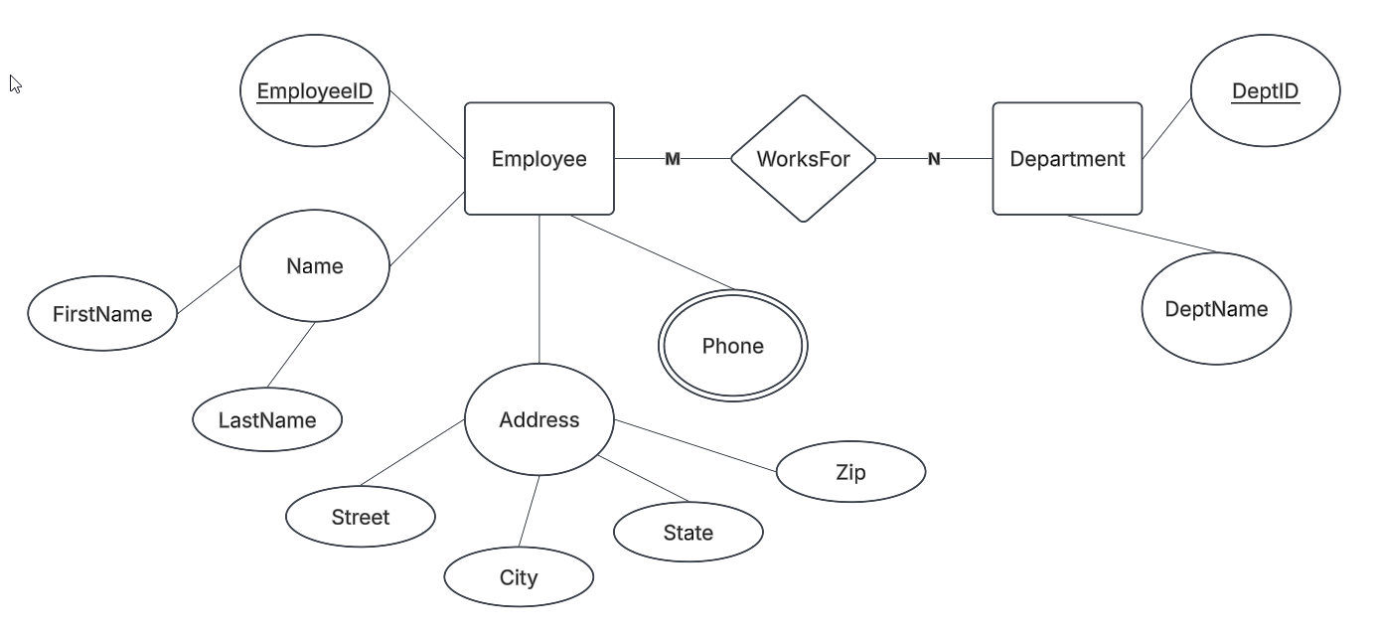
Activity: An employee can work for more than one department

Slide 25
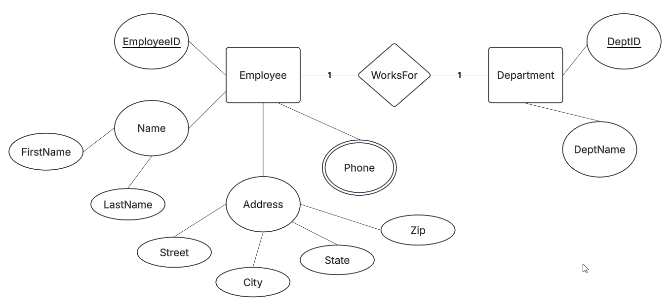

Activity: An employee can work for at most one department.
A department can have at most one employee.
What can you say about this ERD, if it’s a 1-1 relationship?

Slide 26
Participation
ERDs can also indicate whether participation in a relationship is required or optional.
In traditional Chen notation:
Single line → Partial participation
Double line → Total participation

Slide 27
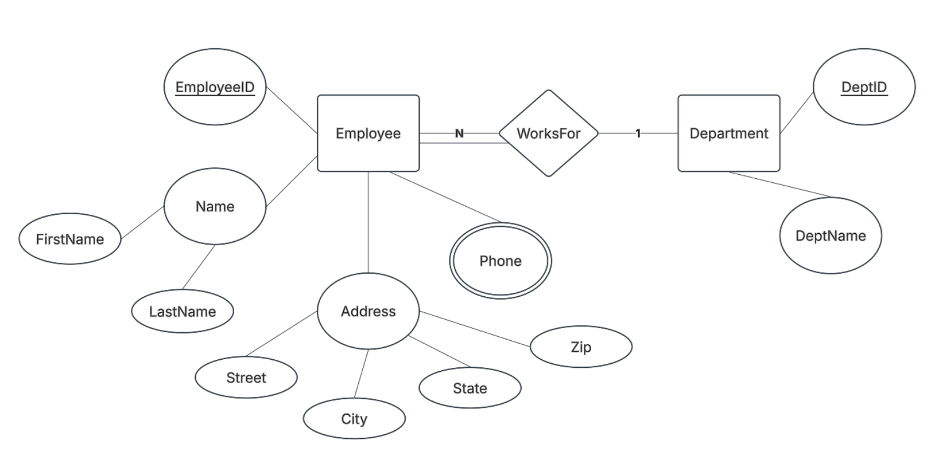
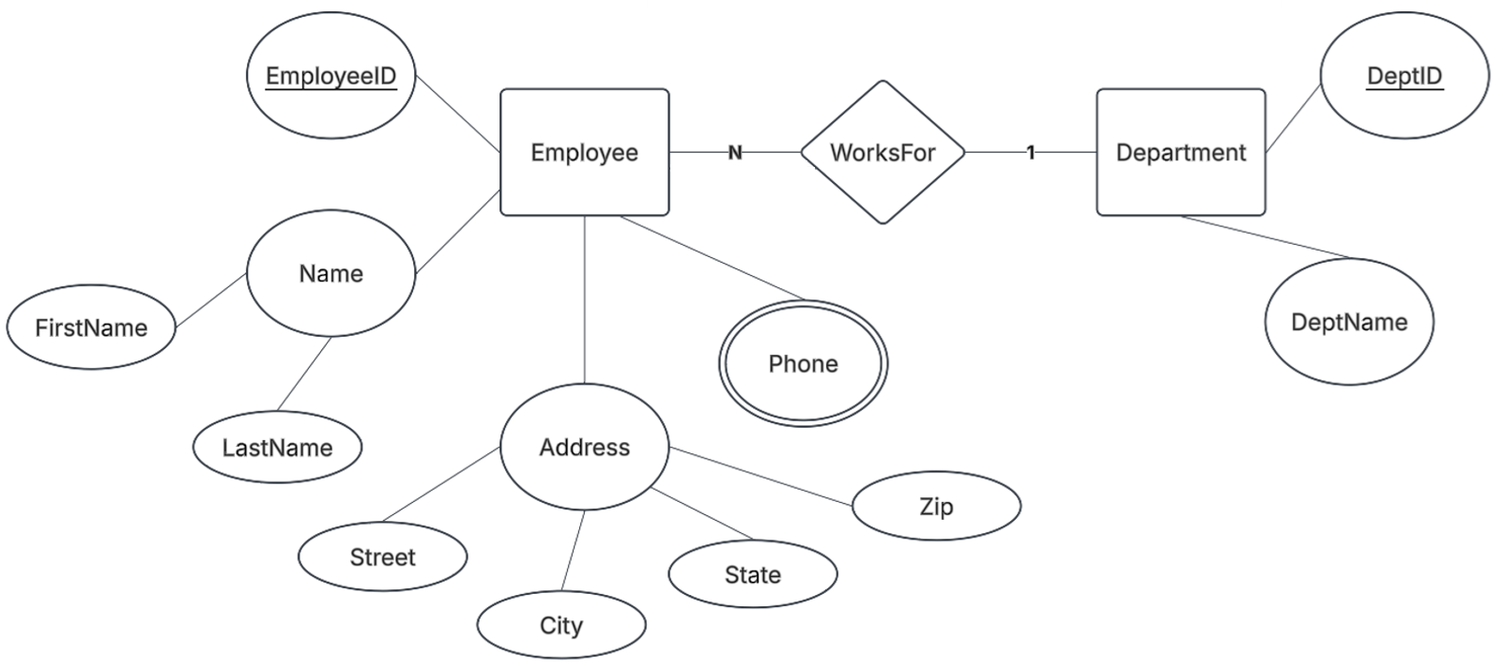
Activity: Business Constraint: Every employee must belong to a department
If the business rules do not state that participation is mandatory, partial participation is often assumed.

Slide 28
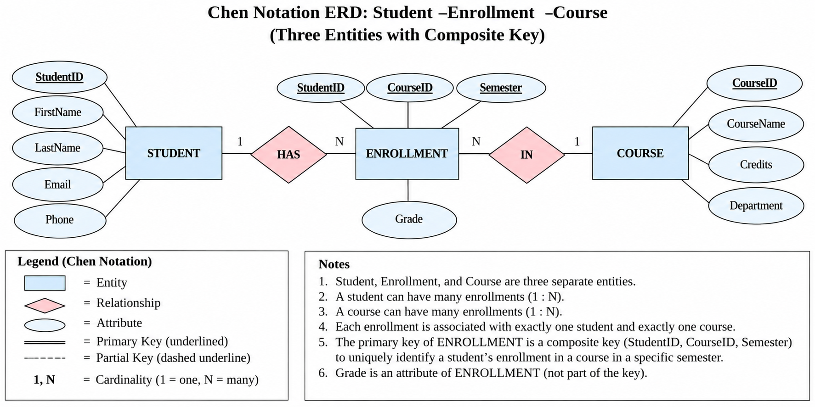

Slide 29
Why ERDs Are Important
An ERD allows a database designer to plan the structure of a database before creating the actual tables. It can help identify missing data, unnecessary duplication, incorrect relationships, and important business rules early in the design process.
Once the ERD has been completed, it can be converted into a relational schema, which can then be implemented as tables using SQL.

